Slide 1

Home Security
with Raspberry Pi

Slide 2
Problem
Who is in my apartment?
Weekdays during work hours

Slide 3
Solution
Motion activated camera
Records clips and saves data
Notifies user via email

Slide 4
Internet of Things
Sensors and actuators
Connectivity
People and processes

Slide 5
Market Analysis
On track to be a multi-billion dollar market
More focus on security
Technological progress
Rise of DIY projects
Insurance company discounts

Slide 6
Market Analysis
The best home security cameras
Price range $100 – $400
Indoor vs. outdoor
Netgear, LG, Nest, Amazon, Uniden

Slide 7
Market Analysis
Wi-fi
Audio
Night vision
Movement
Wide angle lenses
Motion detection

Slide 8
Hardware
Raspberry Pi 3 Model B
Raspberry Pi Camera
Motion sensor
Micro SD card

Slide 9
Software
Raspbian OS
Linux based
Python script

Slide 11
Process
Selecting a Raspberry Pi
Initial setup
Mouse, keyboard, monitor, power
Raspbian OS

Slide 12
Process
Testing the camera
Testing the motion sensor
Putting everything together

Slide 13
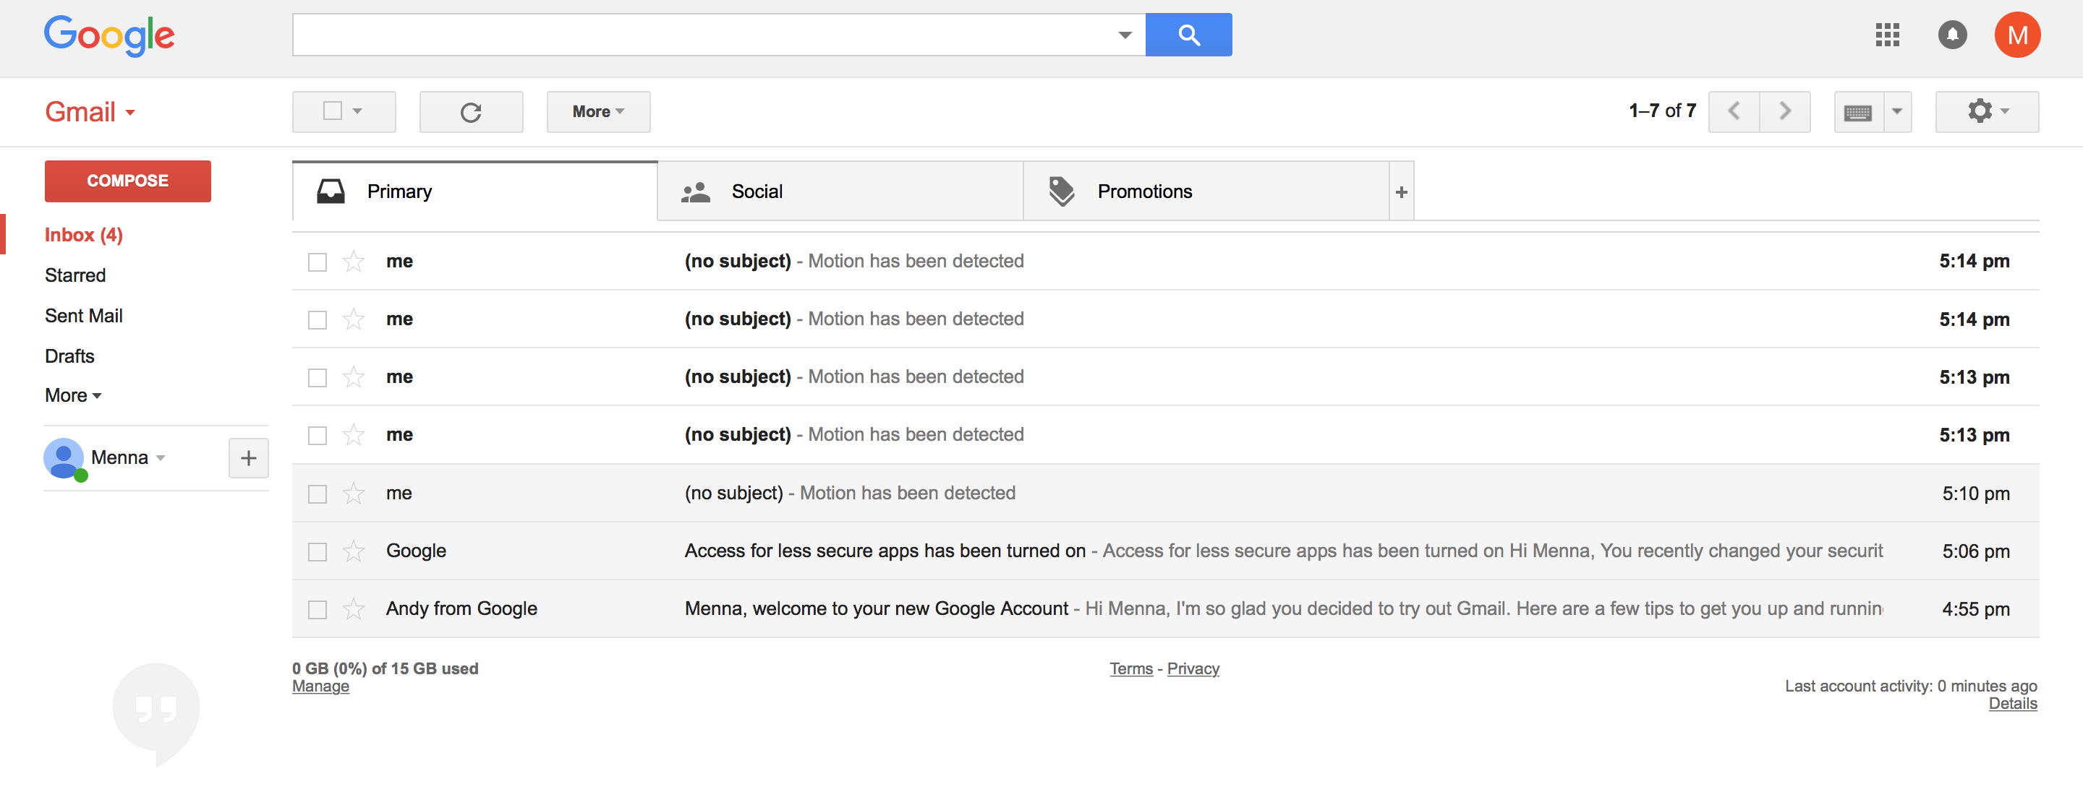
Notification

Slide 14
Improvements
Ambient Technology
Improve notification
Object detection

Slide 15
Lessons learned
Big potential
Always consider usability

Slide 16
References
https://www.raspberrypi.org/documentation/usage/camera/python/README.md
https://myhydropi.com/connecting-a-motion-sensor-to-a-raspberry-pi
http://naelshiab.com/tutorial-send-email-python/
https://www.inc.com/dan-scalco/why-home-security-systems-are-on-track-to-be-a-multi-billion-dollar-market.html
https://www.pcmag.com/article2/0,2817,2475954,00.asp
IoT Infographics – Lecture material

